Slide 1
Relativity Forms API Workshop

Slide 2



Kevin Opperman
Adam Sorna
Keith Kaminski
Justin Dougherty
Notes:
Good morning everyone, my name is Justin Dougherty and I am a product manger at Relativity. I have the pleasure of being joined by three masters of engineering Kevin Opperman, Adam Sorna, and Keith Kaminski.

Slide 3
Course Overview
Setting up your machine
Example Relativity Application
Beginning to Customize Objects with Relativity Forms
Enabling Relativity Forms
Writing Relativity Forms Event Handlers
Reading and Manipulating Fields
Generating Markup
Calling APIs
Notes:
Introduction of people
Walk through the agenda
Setup the VMs
Talk about the application we will migrate to Forms.
Customizations
Interaction event handlers
Console event handler
Close – Check for Understanding
Extra Time
Slides
Workshop code and VM setup.
Relativity Form Fest Workshop Application.
Exercise 1 – Relativity Forms Enablement
Relativity Forms – What it is, and what does it do?.
What does it do differently from classic.
Object customization in Relativity Form. What are the things you need to do to customize. Updating or creating a page interaction event hanlder. Creatin the javascript to support it.
Exercise 2 - Doing an update to the page interaction event handler and the javascript
Key bullet points for the exercise
At the end of this exercise, you should be able to see a consule on our form.
Exercise 3 – Page interaction event hanlders.
Code snippits to guide them through this
The field will turn on and off when for enthusiasm.
Your first conversion is nearly complete. All that remains is a button on the console. We aren’t finshed yet. Let’s use the convienince API. We are going use a convenience API that isn’t documented publicly yet.
Exercise 4 – Console event handler
Setting up the consule with the markup
Attaching the markup to the action.
Filling out the part that does the API call.
Close – Check for understanding
If we have time we could dive into updating browser alerts.

Slide 4
Enhance Relativity Development skills
Interest You in Our New Technology which Excites Us
Why are we doing this workshop?

Slide 5
Getting Started

Slide 6
You should see the following shortcut on the desktop.
‘relativity-forms-workshop Shortcut’
It links to E:\relativity-forms-workshop-fest-2019
Within this folder is a 'docs/workshop/' folder containing a document that has all the instructions for today’s workshop.
Open PowerShell and a do pull on the relativity-forms-workshop-fest-2019 folder
git pull
Workbook
Document

Slide 7
Follow instructions on Section 2.1 to access the various projects that will be used in the workshop.
You have about 5 minutes to complete these instructions.
Workshop Projects

Slide 8
Follow instructions in Section 2.2 on page 8 to set up DevVM for accessing Relativity.
You have about 10 minutes to set up your Dev VM.
DevVM Setup

Slide 9
Example Relativity Application

Slide 10
The application has the following components
Person Object Type
Page Interaction EventHandler
Console EventHandler
Kepler Service
Example
Relativity
Application

Slide 11
Application tracks a Person's enthusiasm levels
Application development halted before completion of Console EventHandler to migrate to Relativity Forms
Example
Relativity
Application

Slide 12
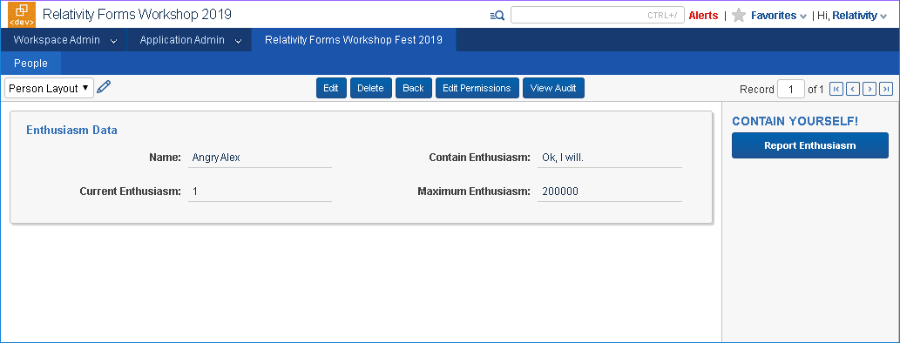
Example Relativity Application

Slide 13
Customizing Object Types
With Relativity Forms

Slide 14
Enabling Relativity Forms
You will have about 10 minutes to complete Exercise 1
Effect of enabling Relativity Forms
Customizing Object Types
Customizing Relativity Forms
You will have about 20 minutes to complete Exercise 2
Updating Page Interaction EventHandler
Using Template Project Automation
Notes:
Necessary for unit testing:
We need our code to be testable to allow us to write tests. If the code cannot be unit tested, we've already got problems!
Makes adding new unit tests simple:
You want to be able to add tests with ease – adding a test should have as few barriers to addition as possible as to encourage contributors to add more tests
Enables future integration testing:
If you follow the patterns and principles suggested here today, you'll set yourself up for easy integration testing in the future

Slide 15
Writing Event Handlers
Relativity Forms JavaScript

Slide 16
Page Interaction
Pipelines
Reading/Manipulating Fields
Reacting to change
You will have about 25 minutes to complete Exercise 3
Writing Event Handlers
Console and Calling Kepler APIs
You will have about 25 minutes to complete Exercise 4
Populating Console
Kepler calls with relativityHttpClient
Notes:
Necessary for unit testing:
We need our code to be testable to allow us to write tests. If the code cannot be unit tested, we've already got problems!
Makes adding new unit tests simple:
You want to be able to add tests with ease – adding a test should have as few barriers to addition as possible as to encourage contributors to add more tests
Enables future integration testing:
If you follow the patterns and principles suggested here today, you'll set yourself up for easy integration testing in the future

Slide 17
Questions?

Slide 18
Platform Documentation: https://platform.relativity.com/RelativityOne/ Relativity Forms: https://platform.relativity.com/RelativityOne/Content/Relativity_Forms/Relativity_Forms_API.htm
Relativity Forms Cheat Sheet: https://github.com/relativitydev/relativity-forms-workshop-fest-2019/raw/master/docs/workshop/Relativity%20Forms%20Cheat%20Sheet.pdf
DevHelp: https://devhelp.relativity.com/c/relativityui/relativityforms Category: RelativityUI Sub-Category: RelativityForms
This Workshop's Materials on GitHub: https://github.com/relativitydev/relativity-forms-workshop-fest-2019
Feedback: RelativityFormsFeedback@relativity.com

